Slide 1



Şenlik Sport Center
Muhammed Canberk Şenlik - 030715040
Programming languages lecture project

Slide 2
Senlik Sport Center
Manager and customer can use that system.
Managers manage the sports and sessions.
Customers register the system to in by register page.
Customers can register the sports if his gender is available.
Managers can see who register the sports.

Slide 3
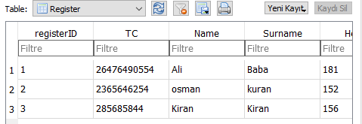
Process
Firstly manager can go to manager page to see who register the sports at the same time with session and genders.
If the visitors want to log in the system, he must register the system the first.
After that, the customer would register in the database and he can log in the system to see the sport of sessions.
Finally, the customer check his session of sport by using the identity number

Slide 4
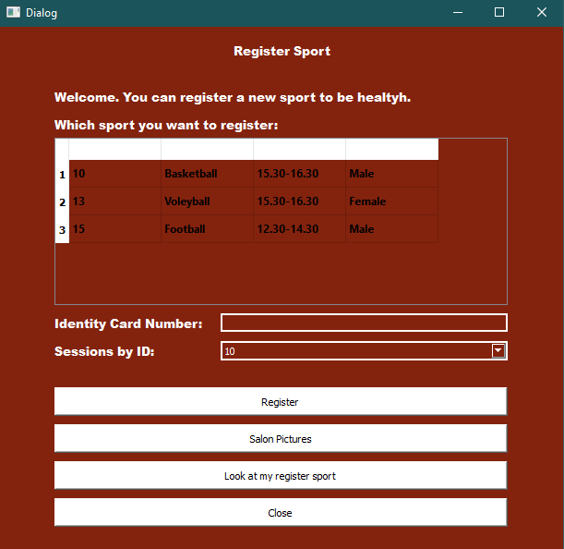
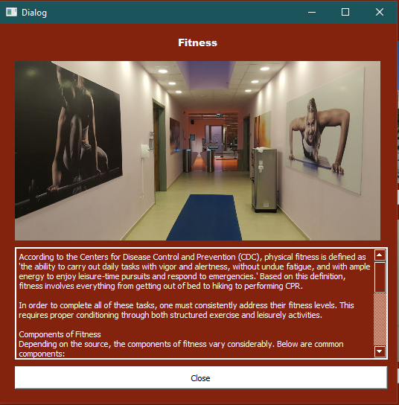
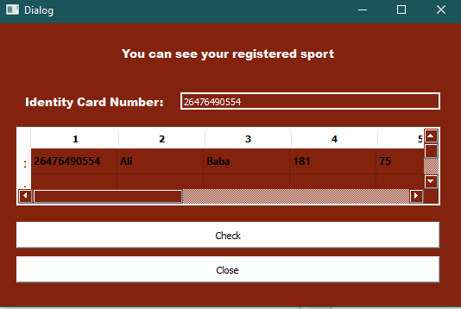
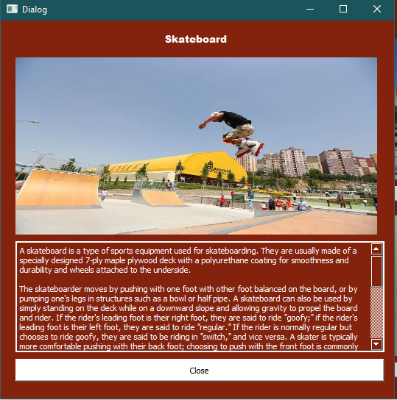
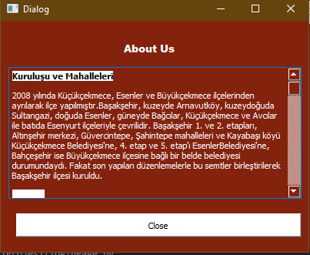
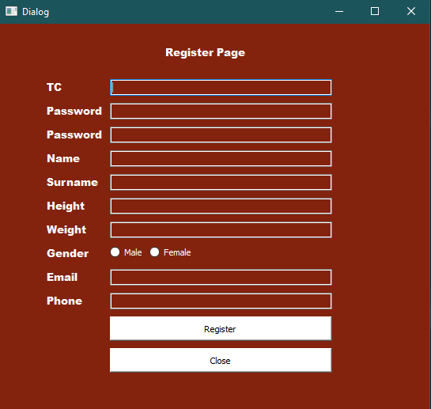
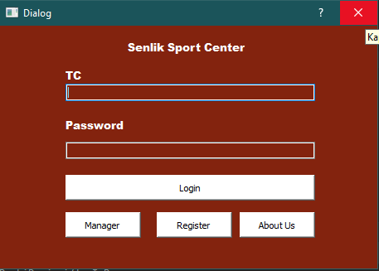
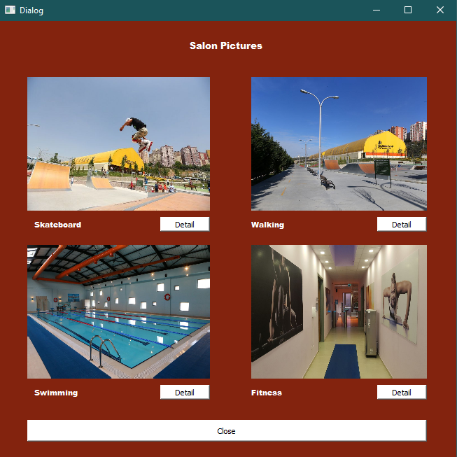
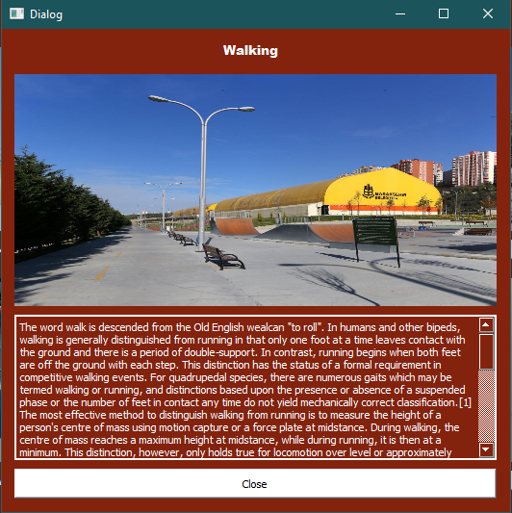
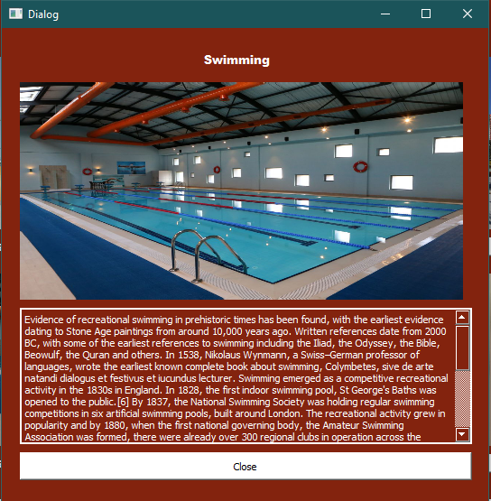
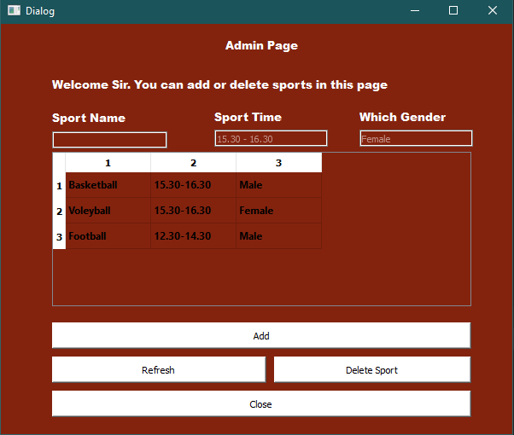
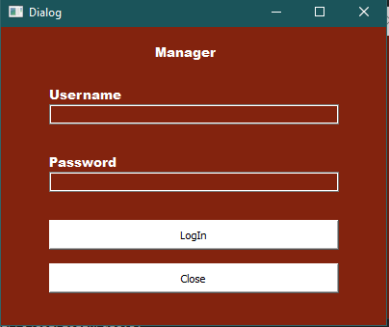
Let’s begin the screenshots and their features

Slide 5
Login page
That’s the first page of the system. The user would be manager or the customer that’s why we would have to separate them about their purposes. Another button for the see more information about the system and company.

Slide 6
Register page
If the customer did not register the system, he can register by using register button and entering the information about himself. After that we can add their information into the database.

Slide 7
About us page
It will contain more information about our company and system. It can also include some experiment of the customers who already use that system before.

Slide 8
Manager login page
We separate the manager of the system in the first page and now, we should check that person is a real manager. That’s why that is a part of verify page. Username and password would get from the database of the system what we already entered by software enginner.

Slide 9
Register sport page FOR customers
We separate the customer of the system in the first page and now, we are pretty sure about him. The customer can see the sports, who registered by manager, to register. After the registering, he can check his information. Another option is looking the salon pictures before he decided.

Slide 10
Salon PICTURES PAGE
If the customer want to see our systems, areas, that page is the certainly good for him. He can see the picture of `Senlik Sport Center` and he can click the detail button to read the details about the sport.

Slide 11
Salon PICTURES Details PAGE
The customer read these information to get more information about the system and sport.

Slide 12
Manager adding sport PAGE
If the manager wants to add a new sport in the system, he can do it by using in this page. The sport must include the time and gender information. Also, the manager can delete the sport which is already added.

Slide 13
Look my scheduling page
If the customer forget his registered sport or he wants to check it, this page would ask his identity card number then it will appear by scaling the database.

Slide 14
Şenlik Sport Center
Thank you
Muhammed Canberk Şenlik- 030715040
Programming languages lecture project

